Slide 1
Wait, What? I can add formative assessment questions directly into my lecture capture recordings??
Dan Thompson
Manager of Instructional Design
and Educational Technology

Slide 2
Session Objectives
At the end of this session, participants will be able to:
Create quizzes in Panopto
Engage students with formative assessment items in Panopto recordings
Evaluate student understanding of course content though embedded formative assessments

Slide 3
Panopto 101
Product/Daily Process
Labeled “lecture capture”, but it’s much much more
All class periods at OSU-CHS are captured and posted same day for student review
The in-class recordings capture the audio from the microphone and the classroom computer

Slide 4
Panopto 202
You can create a recording anywhere!
You just need to be connected to the Internet and have a microphone connected to your computer
Make a mistake during your recording? Don’t start over…you can easily cut out any part of the recording
Videos automatically upload to the intended course
Recommendations:
Keep pre-recorded videos short! 6-10 minutes is ideal.
Add formative assessment items!

Slide 5
Why Formative Assessment?
Preparation for summative exams
Ensure students are prepared for class
Questions assist in focusing students on the important information from the assignment
Student self-assessment
Provides more class time flexibility

Slide 6
Best Practices
Use to prepare for an active learning session!
Pre-class assessments
Direct students to the main points of a presentation
Allow students to self-assess
Provide breaks during lecture capture recordings
Allow students to have some engagement with the material
Provides feedback on student understanding of lecture content

Slide 7
Accessing Panopto
Go through LCMS+
https://okstate.lcmsplus.com/lcms/logon.php?z=1

Slide 8
How to create a video
https://vimeo.com/204418953

Slide 9
How to create a formative assessment
Let’s create one now….

Slide 10
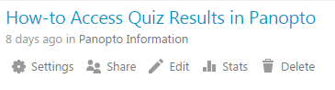
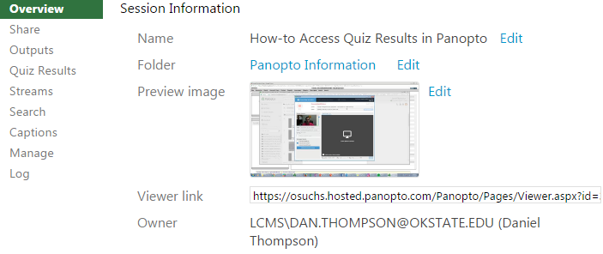
You can get stats too…

Slide 11
Let’s try it!

Slide 12
Thank you!!
Questions
Dan.Thompson@okstate.edu

